Slide 1
CPWH 29 Nov 2017
EQ: Identify and explain motives of New Imperialism.
Agenda:
-Motives of New Imperialism Notes
-Work on Newspaper
Reminders:
-New Imperialism Reading and Lecture Notes Due Friday 12/1
-Race and Religion in Imperialism Test Friday 12/1
-Imperialism Newspaper Due Friday 12/8
You will need 1 piece(s) of paper or continue notes from yesterday

Slide 2


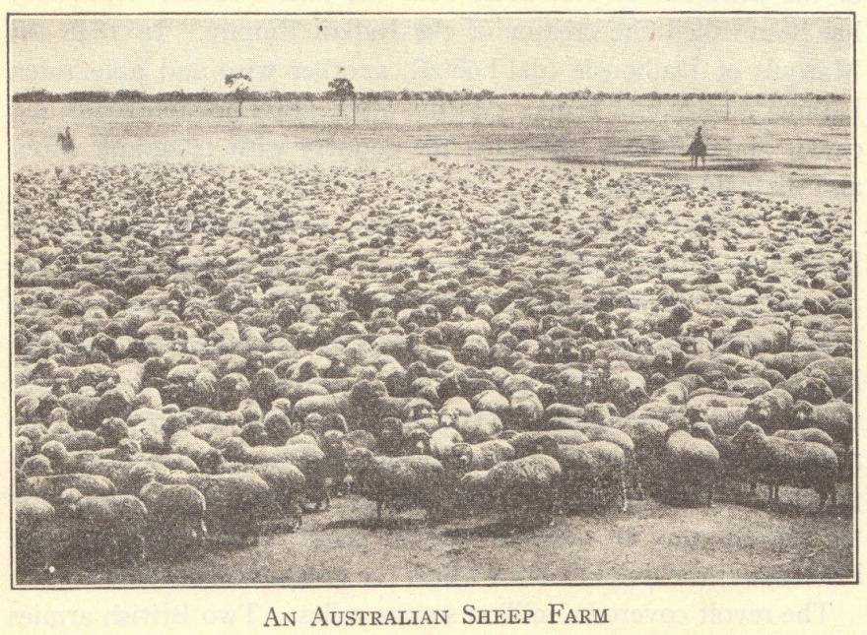


ECONOMIC MOTIVES
Markets for finished goods
  Products of British Industrial Revolution sold in China and India
Sources of raw materials
  Egypt – cotton
  Malaya – rubber and tin
  Middle East – oil
Capital investments
  Profits from Industrial Revolution invested in mines, railroads, etc., in unindustrialized areas
Notes:
Possible anecdote: Many foreign countries had to be coerced to purchase European goods. Railroads were built throughout Europeans’ colonial possessions and in areas where industrialized nations held economic and political influuence.

Slide 3
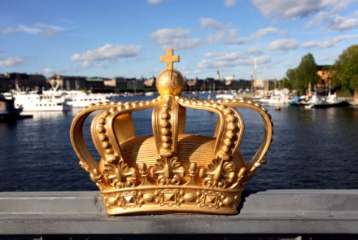
POLITICAL MOTIVES
Nationalism – national pride
“The sun never sets on the British empire.”
Large empires increased national pride
French acquisitions in Africa and Asia followed France’s defeat in the Franco-Prussian War
Notes:
Possible anecdote: The legacy of empires is reflected in languages spoken around the world today, particularly English.

Slide 4

MILITARY MOTIVES
Bases
  British naval bases
    Aden, Alexandria, Cyprus, Hong Kong, Singapore
Manpower
  British – Indian sepoys
  French – north African troops
Notes:
Possible anecdote: Compare the use of native troops within the British and French empires with the use of “barbarian” troops within the Roman empire, with the idea that imperial powers historically have never had enough of their own troops to maintain their empires.

Slide 5

SOCIAL MOTIVES
Surplus population
  Japanese in Korea
  Italians in Africa
“White Man’s Burden”
  Rudyard Kipling’s poetry and prose
  Whites morally obligated to bring the “blessings of civilization” to “backward” peoples
  Cecil Rhodes – imperialism is “philanthropy—plus five percent”
Notes:
Possible anecdote: Did imperial powers bestow any positive benefits? Did these benefits outweigh the costs of colonization?

Slide 6

RELIGIOUS MOTIVES
Conversion to Christianity
End-of-the-century crusading spirit
Missionaries in Africa, Asia, Hawaii, etc.
†
Notes:
Possible anecdote: In what ways did well-intentioned missionaries become cultural imperialists?

Slide 7
JUSTIFICATIONS
Social Darwinism
  Interpreted Darwin’s evolutionary theory in terms of powerful nations
    “Only the strong survive”
  Powerful nations able to develop areas and resources being “wasted” by native peoples
Racism
  Increased feelings of white superiority
    Increased feelings of Japanese superiority
  Eugenics developed as a branch of science
Notes:
Possible anecdote: Racism and eugenics developed and/or increased simultaneously to justify the dominance of imperial powers, both among the Japanese and Europeans.

Slide 8
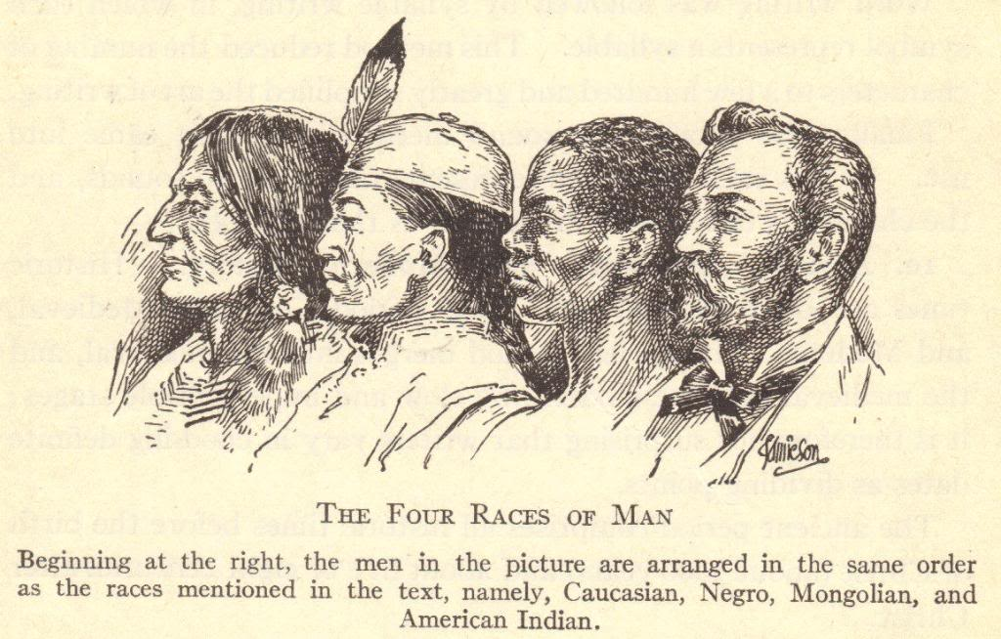
CONCEPT OF “RACES” CIRCA 1900
Notes:
Possible anecdote: Discussion about how the concept of races is outdated and has been proven incorrect through modern research into human migrations and DNA.

