Slide 1
CPWH 28 Nov 2017
EQ: What are key aspects of New Imperialism?
Agenda:
-Race and Religion in Imperialism PreTest
-Imperialism Notes
-Work on Newspaper
Reminders:
-Race and Religion in Imperialism Test Friday 12/1
You will need 1 piece(s) of paper

Slide 2
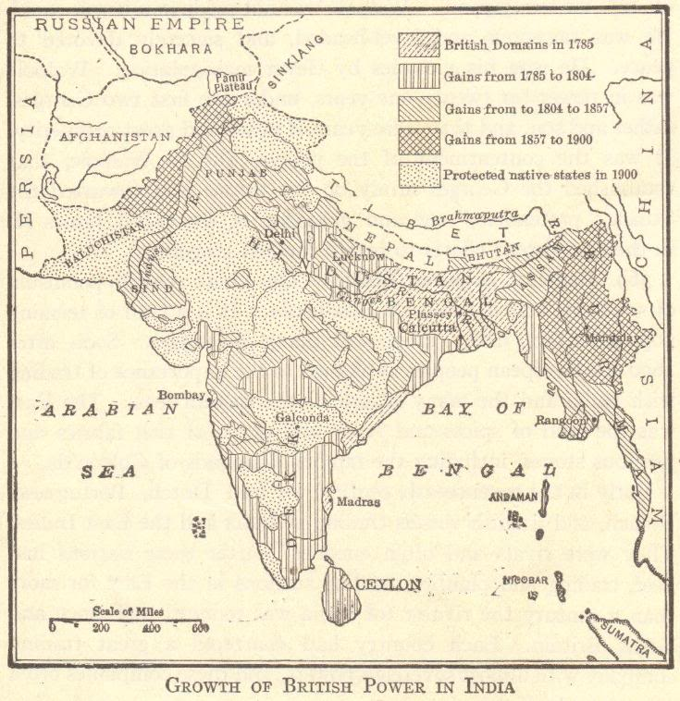
IMPERIALISM: Beginnings and Basic Structures

Slide 3
COLONIALISM SPEEDS UP
Age of Exploration
↓
Europeans raced for overseas colonies
↓
Growth of European commerce and trade worldwide
↓
Commercial Revolution
Notes:
Possible anecdotes: Colonization of the Americas, mercantilism, etc.

Slide 4
“OLD” IMPERIALISM
1500s-1700s
England, France, Holland, Portugal, and Spain
Wars over colonies
Notes:
Possible anecdotes: French and Indian War (Seven Years’ War), Spanish and Portuguese competition in Latin America, etc.

Slide 5
INTERLUDE – LATE 1700s-LATE 1800s
Europeans were preoccupied with happenings on the European continent and in the existing European colonies.
American Revolution
French Revolution
Napoleonic Wars
Latin American Wars for Independence
Growth of Nationalism
Industrial Revolution
Notes:
Possible anecdote: The loss of colonies in the Americas helped spur interest in new colonies while also illustrating the need for change in the nature of imperialism.

Slide 6
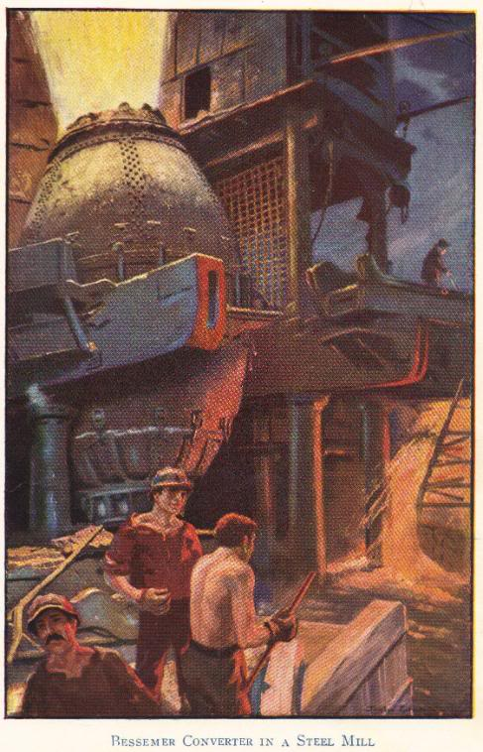
“NEW” IMPERIALISM
Beginning circa 1875
Renewed race for colonies
Spurred by needs created by the Industrial Revolution
New markets for finished goods
New sources of raw materials
Nationalism
Colonies = economic and political power
Social Darwinism = racist justification
Notes:
Possible anecdote: British textile mills required more cotton than could be produced in Great Britain.

Slide 7
WHAT IS “NEW” IMPERIALISM?
No longer about setting up colonies or exercising direct control over areas
Became largely economic
Possession or control of an area for economic gain
Spheres of influence and extraterritoriality rather than colonial settlement

