Slide 1
APWH 25 Oct 2017
EQ: Identify and explain major aspects of trans-regional interactions.
Agenda:
-30-Second Expert
-Image Analysis
-C 7 GO
Reminders:
-C 7 Test 10/27 Fri
-C 7 Notes 10/27 Fri
You will need 0 piece(s) of paper

Slide 2
30-Second Expert
What is “globalization”?
Is “globalization” a recent phenomenon

Slide 3
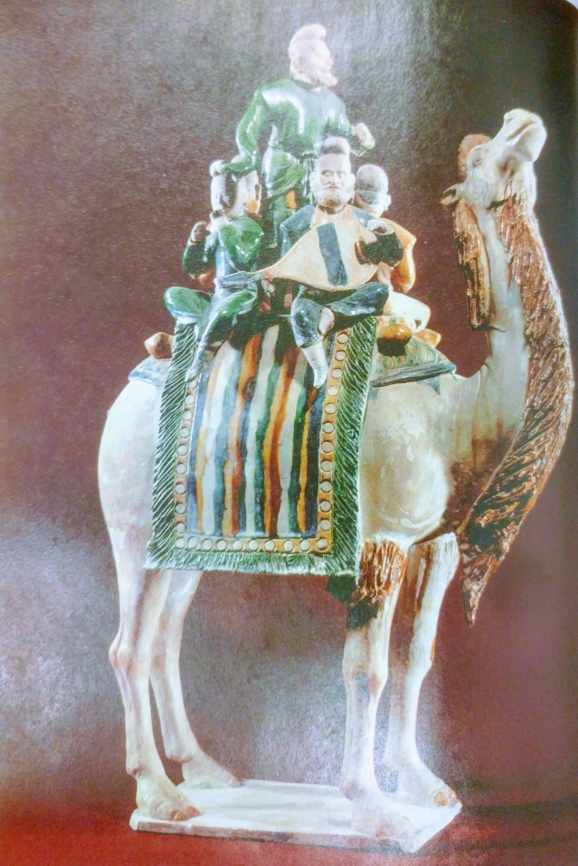
Image Analysis
What instrument is being played by the man on the right?
What do you notice in the figure?
Why do you think the camel plays a central part in the figurine?
What is the significance of having both Central Asian and Chinese merchants together on a camel?

