Slide 1
CPWH 18 Jan 2018
EQ: How was Ethiopia able to defeat Italy at the Battle of Adwa?
Agenda:
-Battle of Adwa Document Analysis
Reminders:
-Reading Quiz: Textbook Pgs. 422-425 (Tomorrow 1/19)
-Reading Quiz: Online “Causes of World War I” (Tue 1/23)
You will need 1 piece(s) of paper

Slide 2
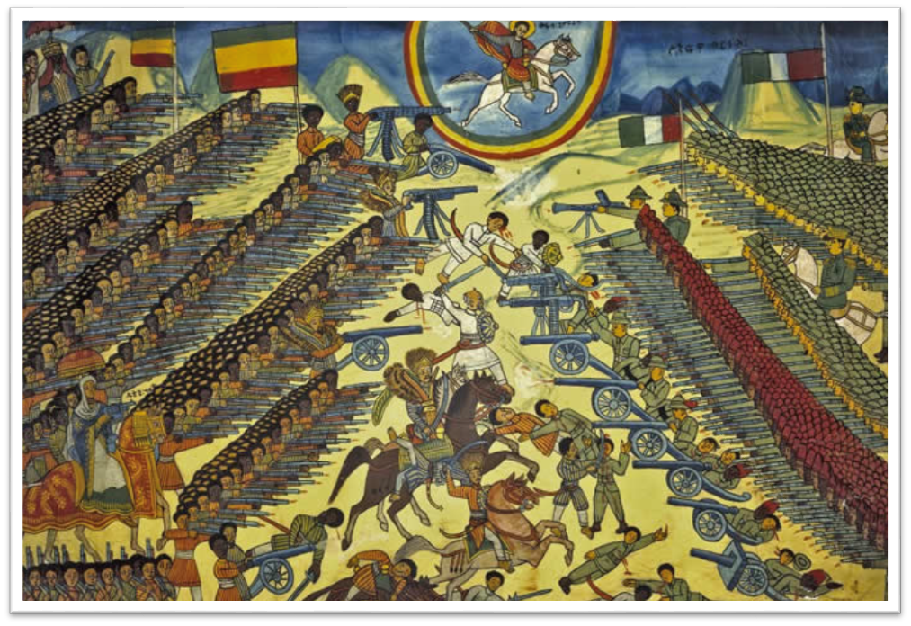
Battle of Adwa

Slide 3
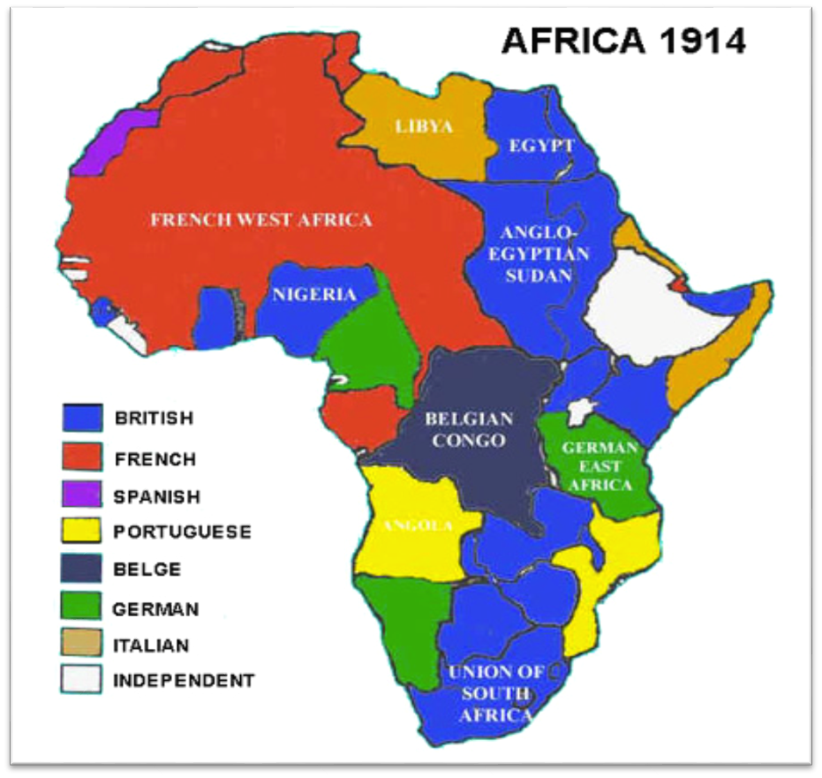
The Scramble for Africa

Slide 4
Central Historical Question
How was Ethiopia able to defeat Italy at the Battle of Adwa?

Slide 5
Ethiopian Independence
“Only the African nation of Ethiopia was able to retain its independence by matching European firepower. In 1889 the emperor of Ethiopia, Menelik II, undertook a program of modernization that included a modern Army.
In 1895, Italian forces invaded Ethiopia over a treaty dispute. Within a year, however, Menelik’s forces – more numerous and better armed than the Italians – defeated the Italians at the Battle of Adwa.” (p.760)
World History Textbook, 2006

Slide 6
Document A: American Textbook
Who, according to this textbook, was most responsible for the Ethiopian victory?
What event led to the battle?
Who, according to this account, started the war?
Why, according to this account, did Ethiopia win the battle?
How is this account similar to and different from the first textbook account?

Slide 7
Document B: Ethiopian Textbook
According to this account, what events led to war between Ethiopia and Italy? How is this version similar to and different from textbook A?
Who, according to this account, started the battle? Why did they start the battle?
Why, according to this account, did Ethiopia win the battle? How does this compare to the other accounts?

Slide 8
Due By End of Period
Write a paragraph using evidence from the documents answering the following:
  How did Ethiopia defeat Italy at the Battle of Adwa?

